Slide 1

P peline
The Data
Announcements
© Jennifer Mankoff
The Data Pipeline; HCII; Spring 2014

Slide 2
Sign up for meetings!
http://tinyurl.com/km3j45d
Next Tuesday, 9-1.

Slide 3
Review of last lecture
What does a z score mean?

Slide 4
Review of last lecture
What does a z score mean?
It tests how good your sample is (how many standard deviations from the population mean the sample mean is)

Slide 5
Review of last lecture
What does a z score mean?
What does a t statistic mean?
where:

Slide 6
Review of last lecture
What does a z score mean?
What does a t statistic mean?
where:
It is an estimated z score (based on an estimated pop mean)

Slide 7
Review of last lecture
What does a z score mean?
What does a t statistic mean?
where:
One use of t is to compare to the critical value t_{α} (look up α and N-1 to get this)
→ Lets us accept or reject H₀ if t > t_{α}

Slide 8
Review of last lecture
What does a z score mean?
What does a t statistic mean?
where:
If we solve for μ
This is just the formula for calculating the confidence interval

Slide 9
Review of last lecture
What does a z score mean?
What does a t statistic mean?
where:
How do we compare two samples?
The square root was missing yesterday. I fixed it in ALL the slides.

Slide 10
Careful with p values
Does not tell us the likelihood something is true. It only lets us reject or accept a hyp.
Gives a yes or no answer: Either the null hypothesis is rejected (the result would be unlikely [defined by α] in a world where the null hypothesis was true) or it cannot be rejected
false negatives: increase α to reduce these
false positives: reduce α to reduce these

Slide 11
Correlation & Regression
Example scatter plot and regression line
Slope
= 0.10977
Intercept
= 98.248
Adapted from http://www.fordham.edu/economics/Vinod/correl-regr.ppt
Notes:
Here, no houses had 0 square feet, so b₀ = 98.24833 just indicates that, for houses within the range of sizes observed, $98,248.33 is the portion of the house price not explained by square feet

Slide 12
Explained and Unexplained Variation
(continued)
y
y_{i}
∧
∧
SSE = ∑(y_{i} - y_{i} )²
y
_
SST = ∑(y_{i} - y)²
∧
y
_
∧
_
SSR = ∑(y_{i} - y)²
_
y
y
x
X_{i}
Notes:
Sse = sum of squared errors
Sst = total sum of squares
Ssr = regression sum of squares

Slide 13
Correlation vs Regression
Pearson correlation coefficient:
Coefficient of determination (Regression):
after minimizing

Slide 14
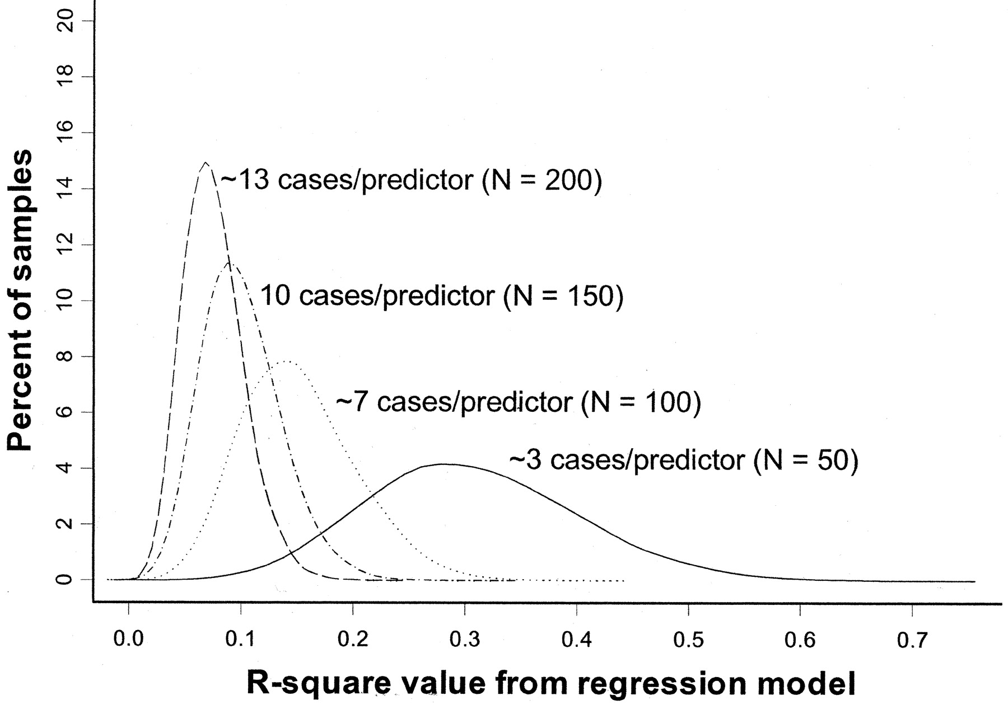
Overfitting simulation (where we know the ‘true’ population has R²=0)
All regression models in simulation have 15 predictors
True R² = 0
(Figure from: Babyak, MA. What You See May Not Be What You Get: A Brief, Nontechnical Introduction to Overfitting in Regression-Type Models. Psychosomatic Medicine 66:411-421 (2004).)
Notes:
The model contained 15 predictors, each consisting of randomly generated values, and a response variable, whose values were also randomly generated

Slide 15
Overfitting: 3 cases/predictor: mean R² looks like .3
R² distribution for 10,000 regressions based on 10,000 random samples of the data (N=50).
(Figure from: Babyak, MA. What You See May Not Be What You Get: A Brief, Nontechnical Introduction to Overfitting in Regression-Type Models. Psychosomatic Medicine 66:411-421 (2004).)
Notes:
Y axis is percent of sample distributions that had a given R2 value (for that N). X axis is distribution of R2 values across the 10,000 regressions (for that N)

Slide 16
Overfitting: 13 cases/predictor: mean R² looks like .05
R² distribution for 10,000 regressions based on 10,000 random samples of the data (N=200)
(Figure from: Babyak, MA. What You See May Not Be What You Get: A Brief, Nontechnical Introduction to Overfitting in Regression-Type Models. Psychosomatic Medicine 66:411-421 (2004).)

Slide 17
Quiz 6

Slide 18
Feedback: Biggest Issues
Thanks for your helpfulness & honesty
Can’t address everything now (or even this year) but a few comments
More examples
Notes:
Each year we build up more great examples. Also I pick the best each year and you go further – raising the class bar ☺

Slide 19
Feedback: Biggest Issues
Thanks for your helpfulness & honesty
Can’t address everything now (or even this year) but a few comments
More examples
Byte / tutorial difficulties
Notes:
Some say too hard, some say too easy, some say too specific, some say too unspecific. To me the biggest thing I learned this year was to ensure more time for the projects. That’s where you get to go in more depth ☺.

Slide 20
Feedback: Biggest Issues
Thanks for your helpfulness & honesty
Can’t address everything now (or even this year) but a few comments
More examples
Byte / tutorial difficulties
More datasets
Notes:
Please, use more! Don’t let me stop you! Incorporating more in the bytes is hard, but please connect with me if you have questions about how to use more in the projects.

Slide 21
Feedback: Biggest Issues
Thanks for your helpfulness & honesty
Can’t address everything now (or even this year) but a few comments
More examples
Byte / tutorial difficulties
More datasets
Big Data
Notes:
We’re getting there. Need to understand small data first!

Slide 22
Review: Decision Trees & Naïve Bayes
Minimum description length principal
- just Keep It Simple, …

Slide 23
Review: Decision Trees & Naïve Bayes
Minimum description length principal
Decision trees are simple and easily learned
Add nodes based on information gain
Decision trees pros
Open world assumption
Fast to learn and use
Easy to interpret and understand
Decision trees cons
Prone to overfitting – handle this by pruning

Slide 24
Review: Decision Trees & Naïve Bayes
Minimum description length principal
Decision trees are simple and easily learned
Add nodes based on information gain
Naïve Bayes – based on Bayes’ law
P(F | C_{i}) P(C_{i})
Likelihood * Prior
P(C_{i} | F) =
=
P(F)
Evidence

Slide 25
Review: Decision Trees & Naïve Bayes
Minimum description length principal
Decision trees are simple and easily learned
Add nodes based on information gain
Naïve Bayes pros
Takes priors into account
Robust even when features are missing
Naïve Bayes cons
Assumptions: Independence; Closed world
Fails when things are highly conditional
Fails when data is highly skewed

